Slide 1
Serverless function using AWS
CLOUD COMPUTING PROJECT
PRESENTED BY:
DUVVURU GANESH
ORGANIZED BY:
TECH VEDHU

Slide 2
Introduction:
This project demonstrates a serverless architecture using AWS services. The system processes serverless function through API Gateway and AWS Lambda, stores the data in DynamoDB, and monitors execution through CloudWatch logs. The project eliminates the need for managing servers and provides a scalable, cost-effective solution.

Slide 3
Objectives:
To understand serverless computing using AWS Lambda.
To integrate API Gateway with Lambda functions.
To store and retrieve data using Amazon DynamoDB.
To monitor application execution using Amazon CloudWatch.
To implement an end-to-end serverless application.

Slide 4
Technology Used:
AWS Lambda
Amazon API Gateway
Amazon DynamoDB
Amazon CloudWatch
IAM (Identity and Access Management)
Python 3.12
Postman

Slide 5
Methodology:
Created a DynamoDB table named "studentData".
Created a Lambda function named "formprocessor".
Configured IAM permissions for Lambda to access DynamoDB.
Developed Python code to insert student records into DynamoDB.
Configured API Gateway and integrated it with Lambda.
Tested API requests using Postman.
Verified data insertion in DynamoDB.
Monitored execution logs using CloudWatch.

Slide 6
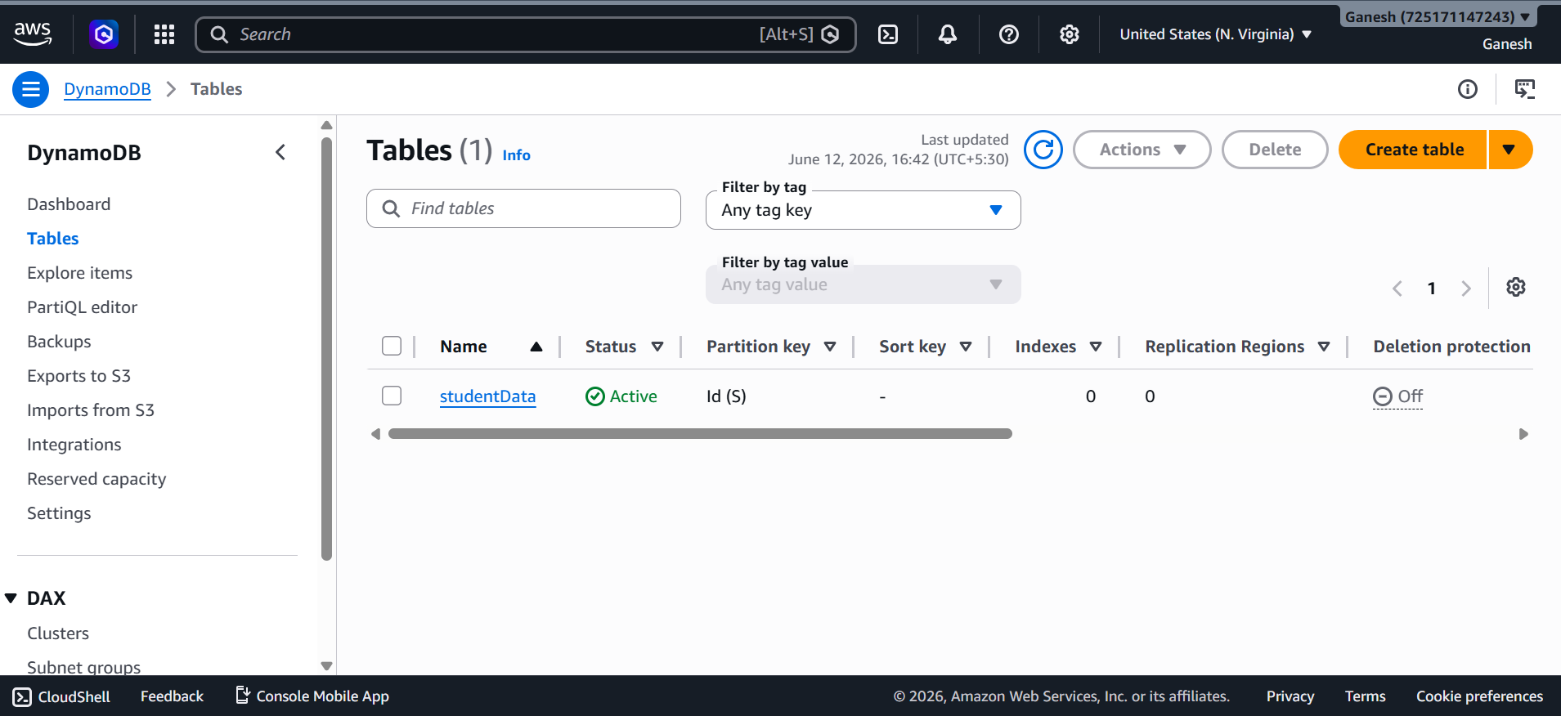
DynamoDB Table:

Slide 7
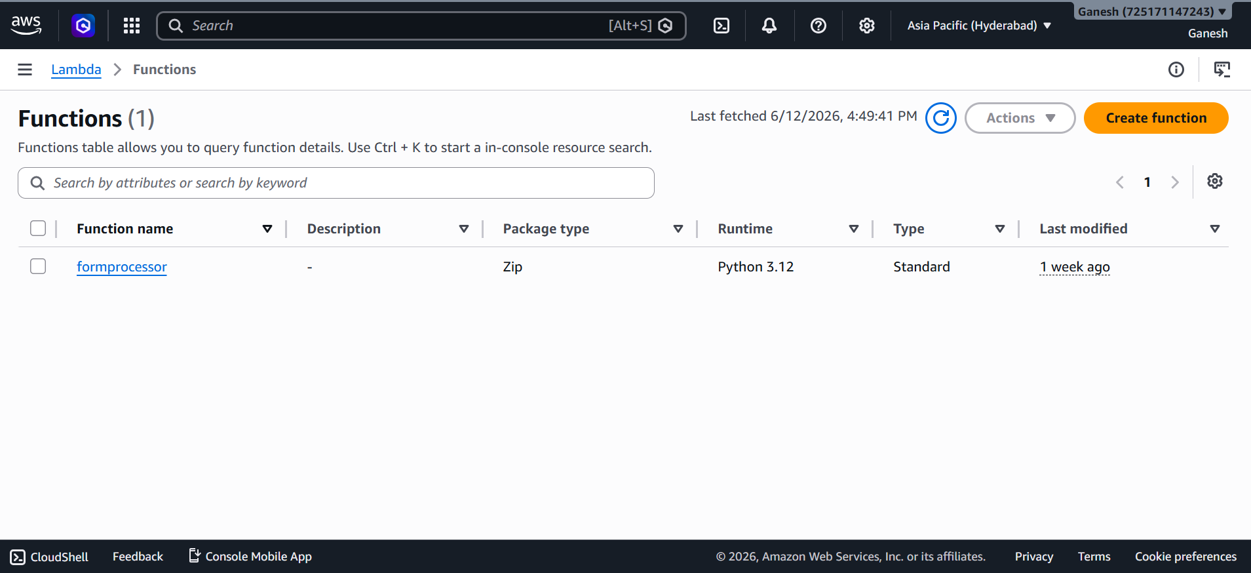
2. Lamda Function:

Slide 8
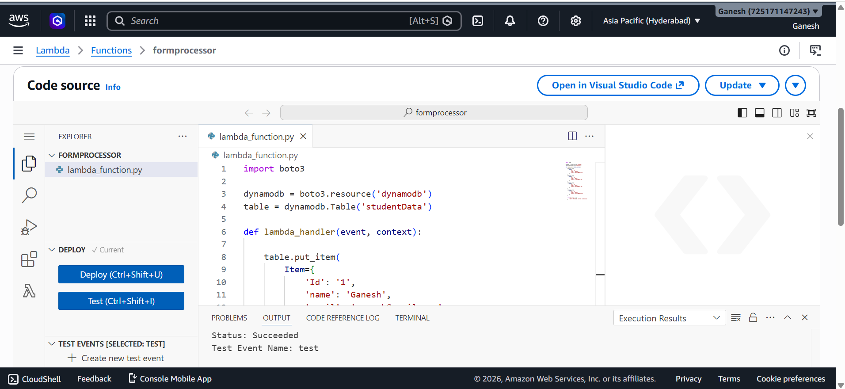
3. Code Source:

Slide 9
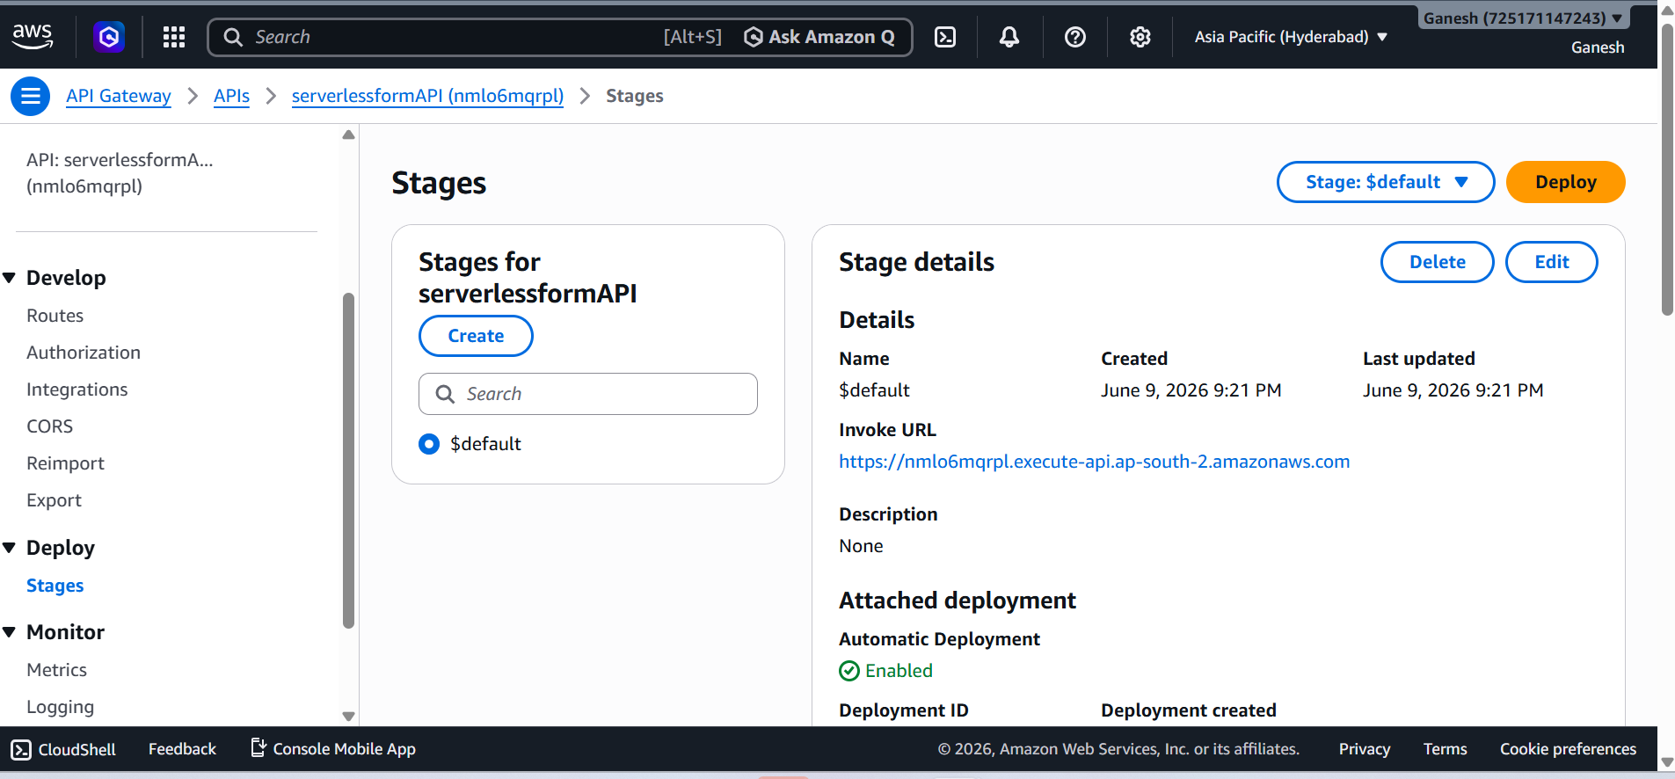
3. API Gateway:

Slide 10
Architecture:
Client/Postman
API Gateway
AWS Lambda (formprocessor)
DynamoDB (studentData)
CloudWatch Logs

Slide 11
Output
Successfully created a serverless application.
Student records were inserted into DynamoDB.
API Gateway successfully triggered Lambda execution.
CloudWatch logs recorded all executions.
End-to-end integration was validated using Postman.

Slide 12
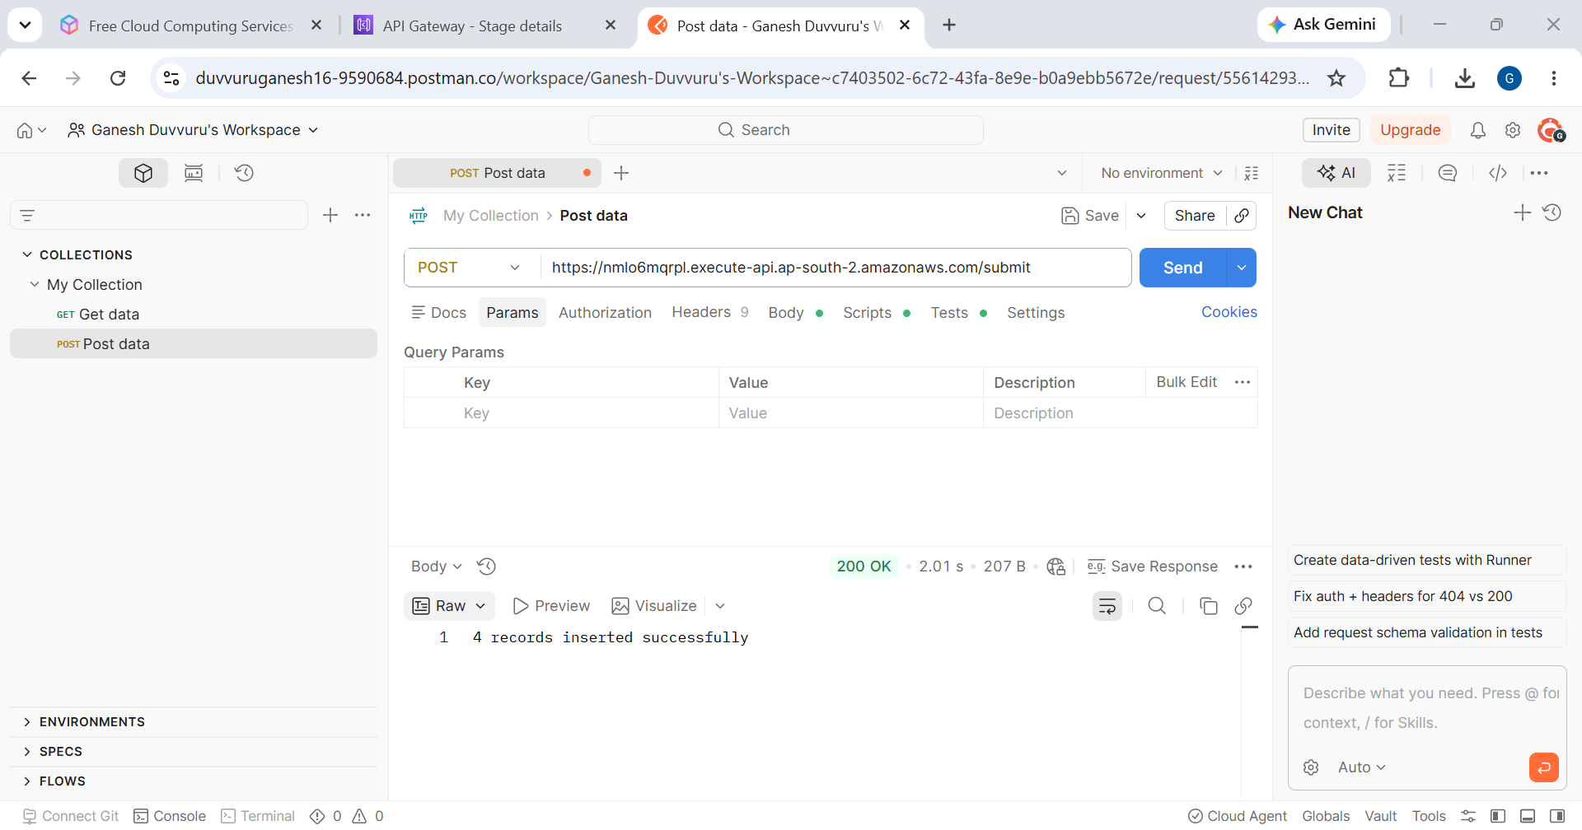
1. Postman Test:
Url: PostmanTest

Slide 13
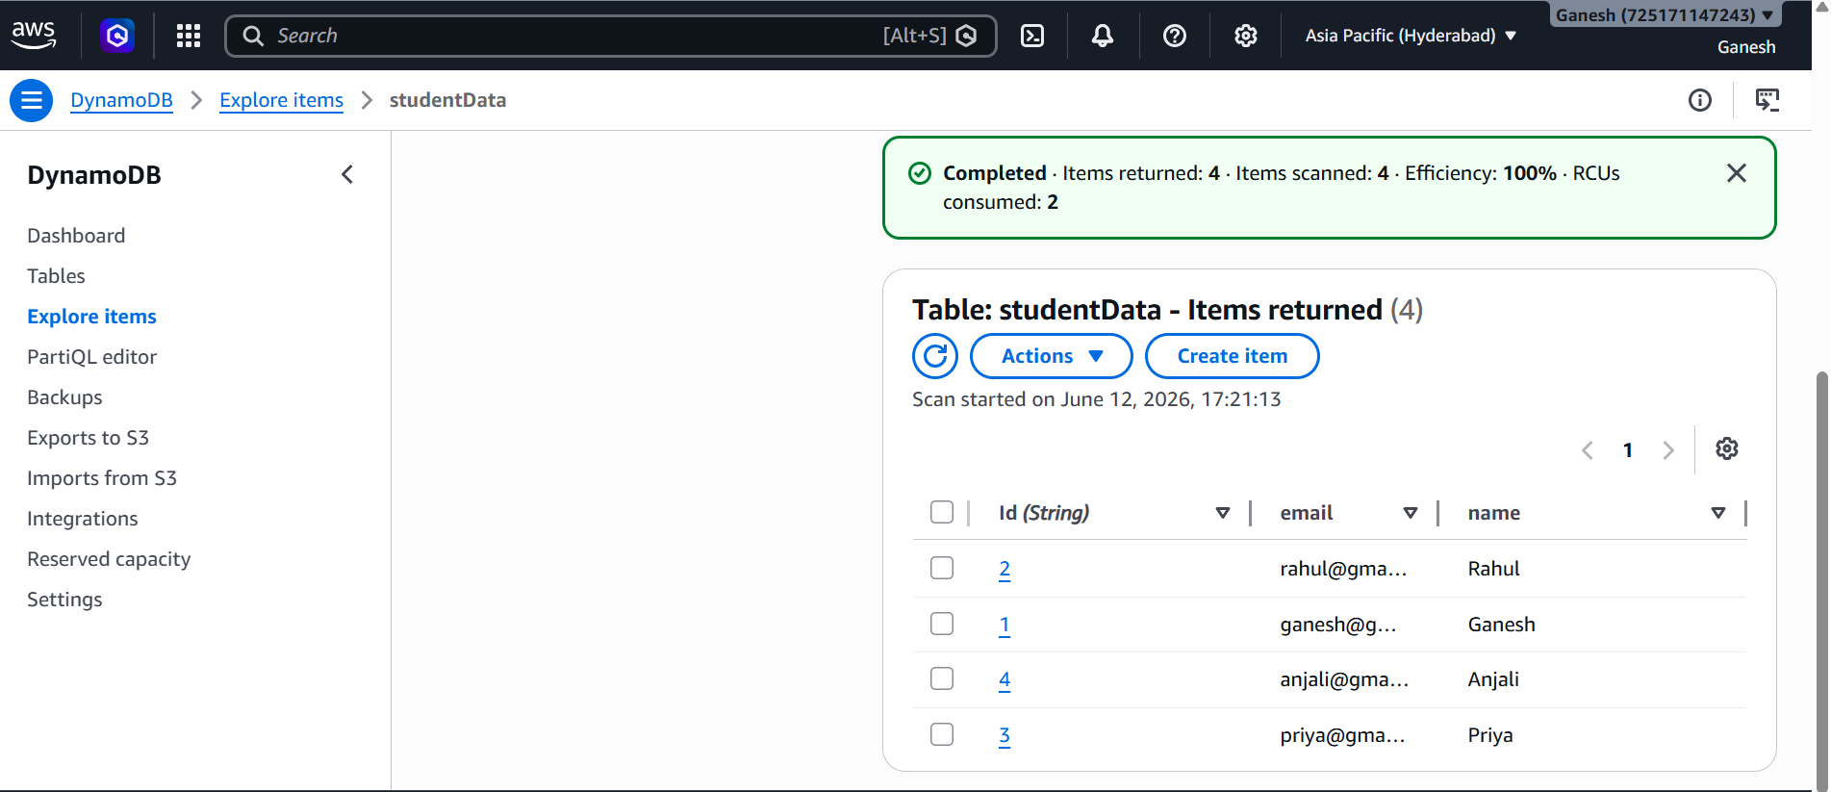
2. DynamoDb Records:

Slide 14
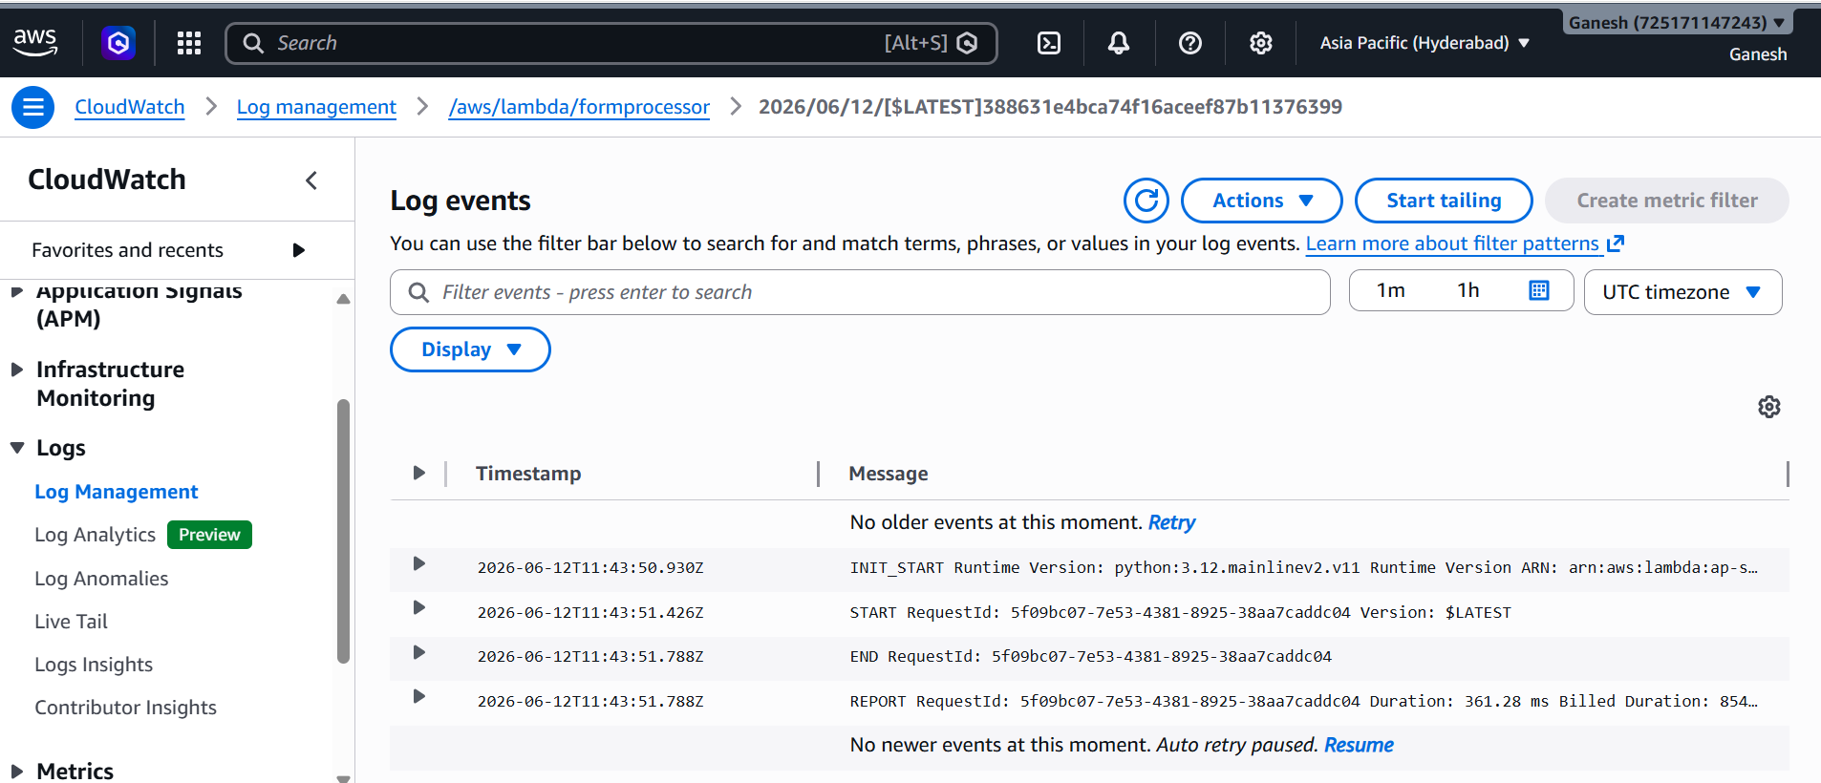
3. CloudWatch Logs:

Slide 15
Conclusion:
The project successfully implemented a serverless architecture using AWS services. API Gateway, Lambda, DynamoDB, and CloudWatch were integrated to process and store student data without managing servers. The solution is scalable, efficient, and suitable for cloud-native applications.

Slide 16
THANK YOU

